Slide 1
Error control coding for wireless communication technologies
Background material for Hamming codes
EU-USA Atlantis Programme
FIT & Budapest University of Technology and Economics

Slide 2
Objective
Design a code which can correct every single error.
Motivation:
If the channel is good then it is enough to have a limited error correcting capability.

Slide 3
Hamming codes
Capable of correcting every single error, they are perfect codes:
Construction of C(n,k) Hamming code:
Construct the column vectors of the parity check matrix H by fulfilling that all column vectors must be different form each other and none of them can be the all zero vector
Construct the generator matrix
Design the matching gates syndrome decoding
Implement the full scheme

Slide 4
The C(7,4) Hamming code
Constructing the parity check matrix H
Constructing the generator matrix G

Slide 5
Step 2: Constructing the parity check matrix H
Step 3: Constructing the generator matrix G

Slide 6
Constructing the matching system for decoding
Match (1)/Mismatch (0)
Matching systems
Match (1)/Mismatch (0)

Slide 7
E.g.
Match (1)/Mismatch (0)
Matching systems
Match (1)/Mismatch (0)

Slide 8
E.g.
Match (1)/Mismatch (0)
Matching systems
Match (1)/Mismatch (0)

Slide 9
E.g.
Match (1)/Mismatch (0)
Matching systems
Match (1)/Mismatch (0)

Slide 10
E.g.
Match (1)/Mismatch (0)
Matching systems
Match (1)/Mismatch (0)

Slide 11
E.g.
Match (1)/Mismatch (0)
Matching systems
Match (1)/Mismatch (0)

Slide 12
E.g.
Match (1)/Mismatch (0)
Matching systems
Match (1)/Mismatch (0)

Slide 13
E.g.
Match (1)/Mismatch (0)
Matching systems
Match (1)/Mismatch (0)

Slide 14
Implementation
Mathcing system
Mathcing system
e
u
v
s
Mathcing system
G
H
BSC with
Mathcing system
e
c
u
Trunc
Mathcing system
Mathcing system
Mathcing system

Slide 15
The coding scheme
s | e
000 | 00000
001 | 00001
010 | 00010
011 | 00011
100 | 00100
101 | 00101
110 | 10000
111 | 01000
00100
01111
01011
100
01111
01
00100
01
Trunc

Slide 16
Bit error probability analysis
u
Array off masking gates or LUT
G
H
Trunc
BSC with
u
BSC’
u'
Given a BSC with
it tells us how to choose n and k parameters to fulfill a given

Slide 17
Code design from the point of communication engineering
Given a BSC with
and a required level of QoS
, design a code which can achieve
1. Evaluate
if n-k is too large or if
then there is no solution with correcting only single errors
(then you need a more powerful code capable of correcting more than a single error)
2. Construct the parity check matrix obeying the rules: (i) each column vector is different; (ii) none of the column vector is the all-zero vector; (iii) the code is systematic
3. Implement the coding scheme
u
Array of masking gates or LUT
G
H
Trunc
BSC with

Slide 18
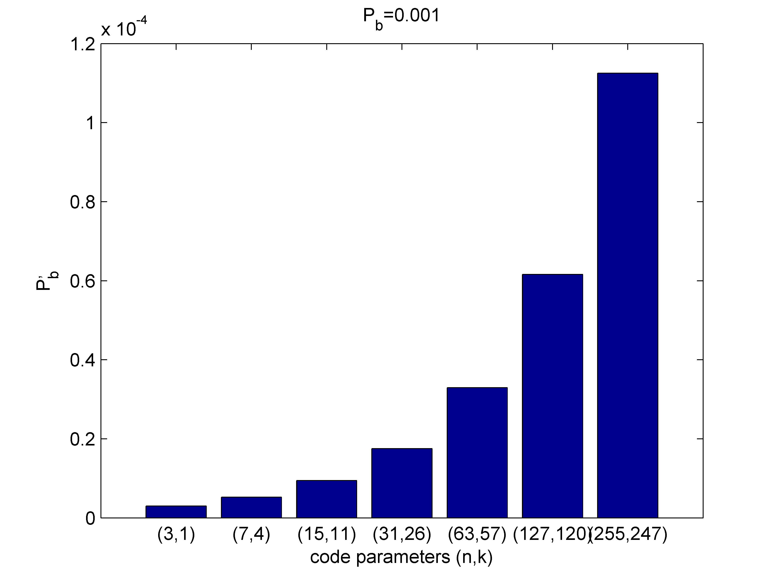
Design an error correcting code for a BSC (BER=0.01) to achieve BER’=0.00001
Step 1: indetifying the code parameters
n=7, k=4

Slide 19
Suggested readings
D. Costello: Error control codes, Wiley, 2005, Chapter 3

Slide 20
Thank you for your attention !

