Slide 1




Error control coding for wireless communication technologies
Background material for Hamming codes
EU-USA Atlantis Programme
FIT & Budapest University of Technology and Economics

Slide 2
Objective
Design a code which can correct every single error.
Motivation:
If the channel is good then it is enough to have a limited error correcting capability.

Slide 3
Hamming codes
Capable of correcting every single error, they are perfect codes:
Construction of C(n,k) Hamming code:
Construct the column vectors of the parity check matrix H by fulfilling that all column vectors must be different form each other and none of them can be the all zero vector
Construct the generator matrix
Design the matching gates syndrome decoding
Implement the full scheme

Slide 4
The C(7,4) Hamming code
Constructing the parity check matrix H
Constructing the generator matrix G

Slide 5
Step 2: Constructing the parity check matrix H
Step 3: Constructing the generator matrix G

Slide 6
Constructing the matching system for decoding
Match (1)/Mismatch (0)
Matching systems
Match (1)/Mismatch (0)

Slide 7
E.g.
Match (1)/Mismatch (0)
Matching systems
Match (1)/Mismatch (0)

Slide 8
E.g.
Match (1)/Mismatch (0)
Matching systems
Match (1)/Mismatch (0)

Slide 9
E.g.
Match (1)/Mismatch (0)
Matching systems
Match (1)/Mismatch (0)

Slide 10
E.g.
Match (1)/Mismatch (0)
Matching systems
Match (1)/Mismatch (0)

Slide 11
E.g.
Match (1)/Mismatch (0)
Matching systems
Match (1)/Mismatch (0)

Slide 12
E.g.
Match (1)/Mismatch (0)
Matching systems
Match (1)/Mismatch (0)

Slide 13
E.g.
Match (1)/Mismatch (0)
Matching systems
Match (1)/Mismatch (0)

Slide 14
Implementation
Mathcing system
Mathcing system
e
u
v
s
Mathcing system
G
H
BSC with
Mathcing system
e
c
u
Trunc
Mathcing system
Mathcing system
Mathcing system

Slide 15
Code design from the point of communication engineering
Given a BSC with
and a required level of QoS
, design a code which can achieve
1. Evaluate
if n-k is too large or if
then there is no solution with correcting only single errors
(then you need a more powerful code capable of correcting more than a single error)
2. Construct the parity check matrix obeying the rules: (i) each column vector is different; (ii) none of the column vector is the all-zero vector; (iii) the code is systematic
3. Implement the coding scheme
u
Array of masking gates or LUT
G
H
Trunc
BSC with

Slide 16
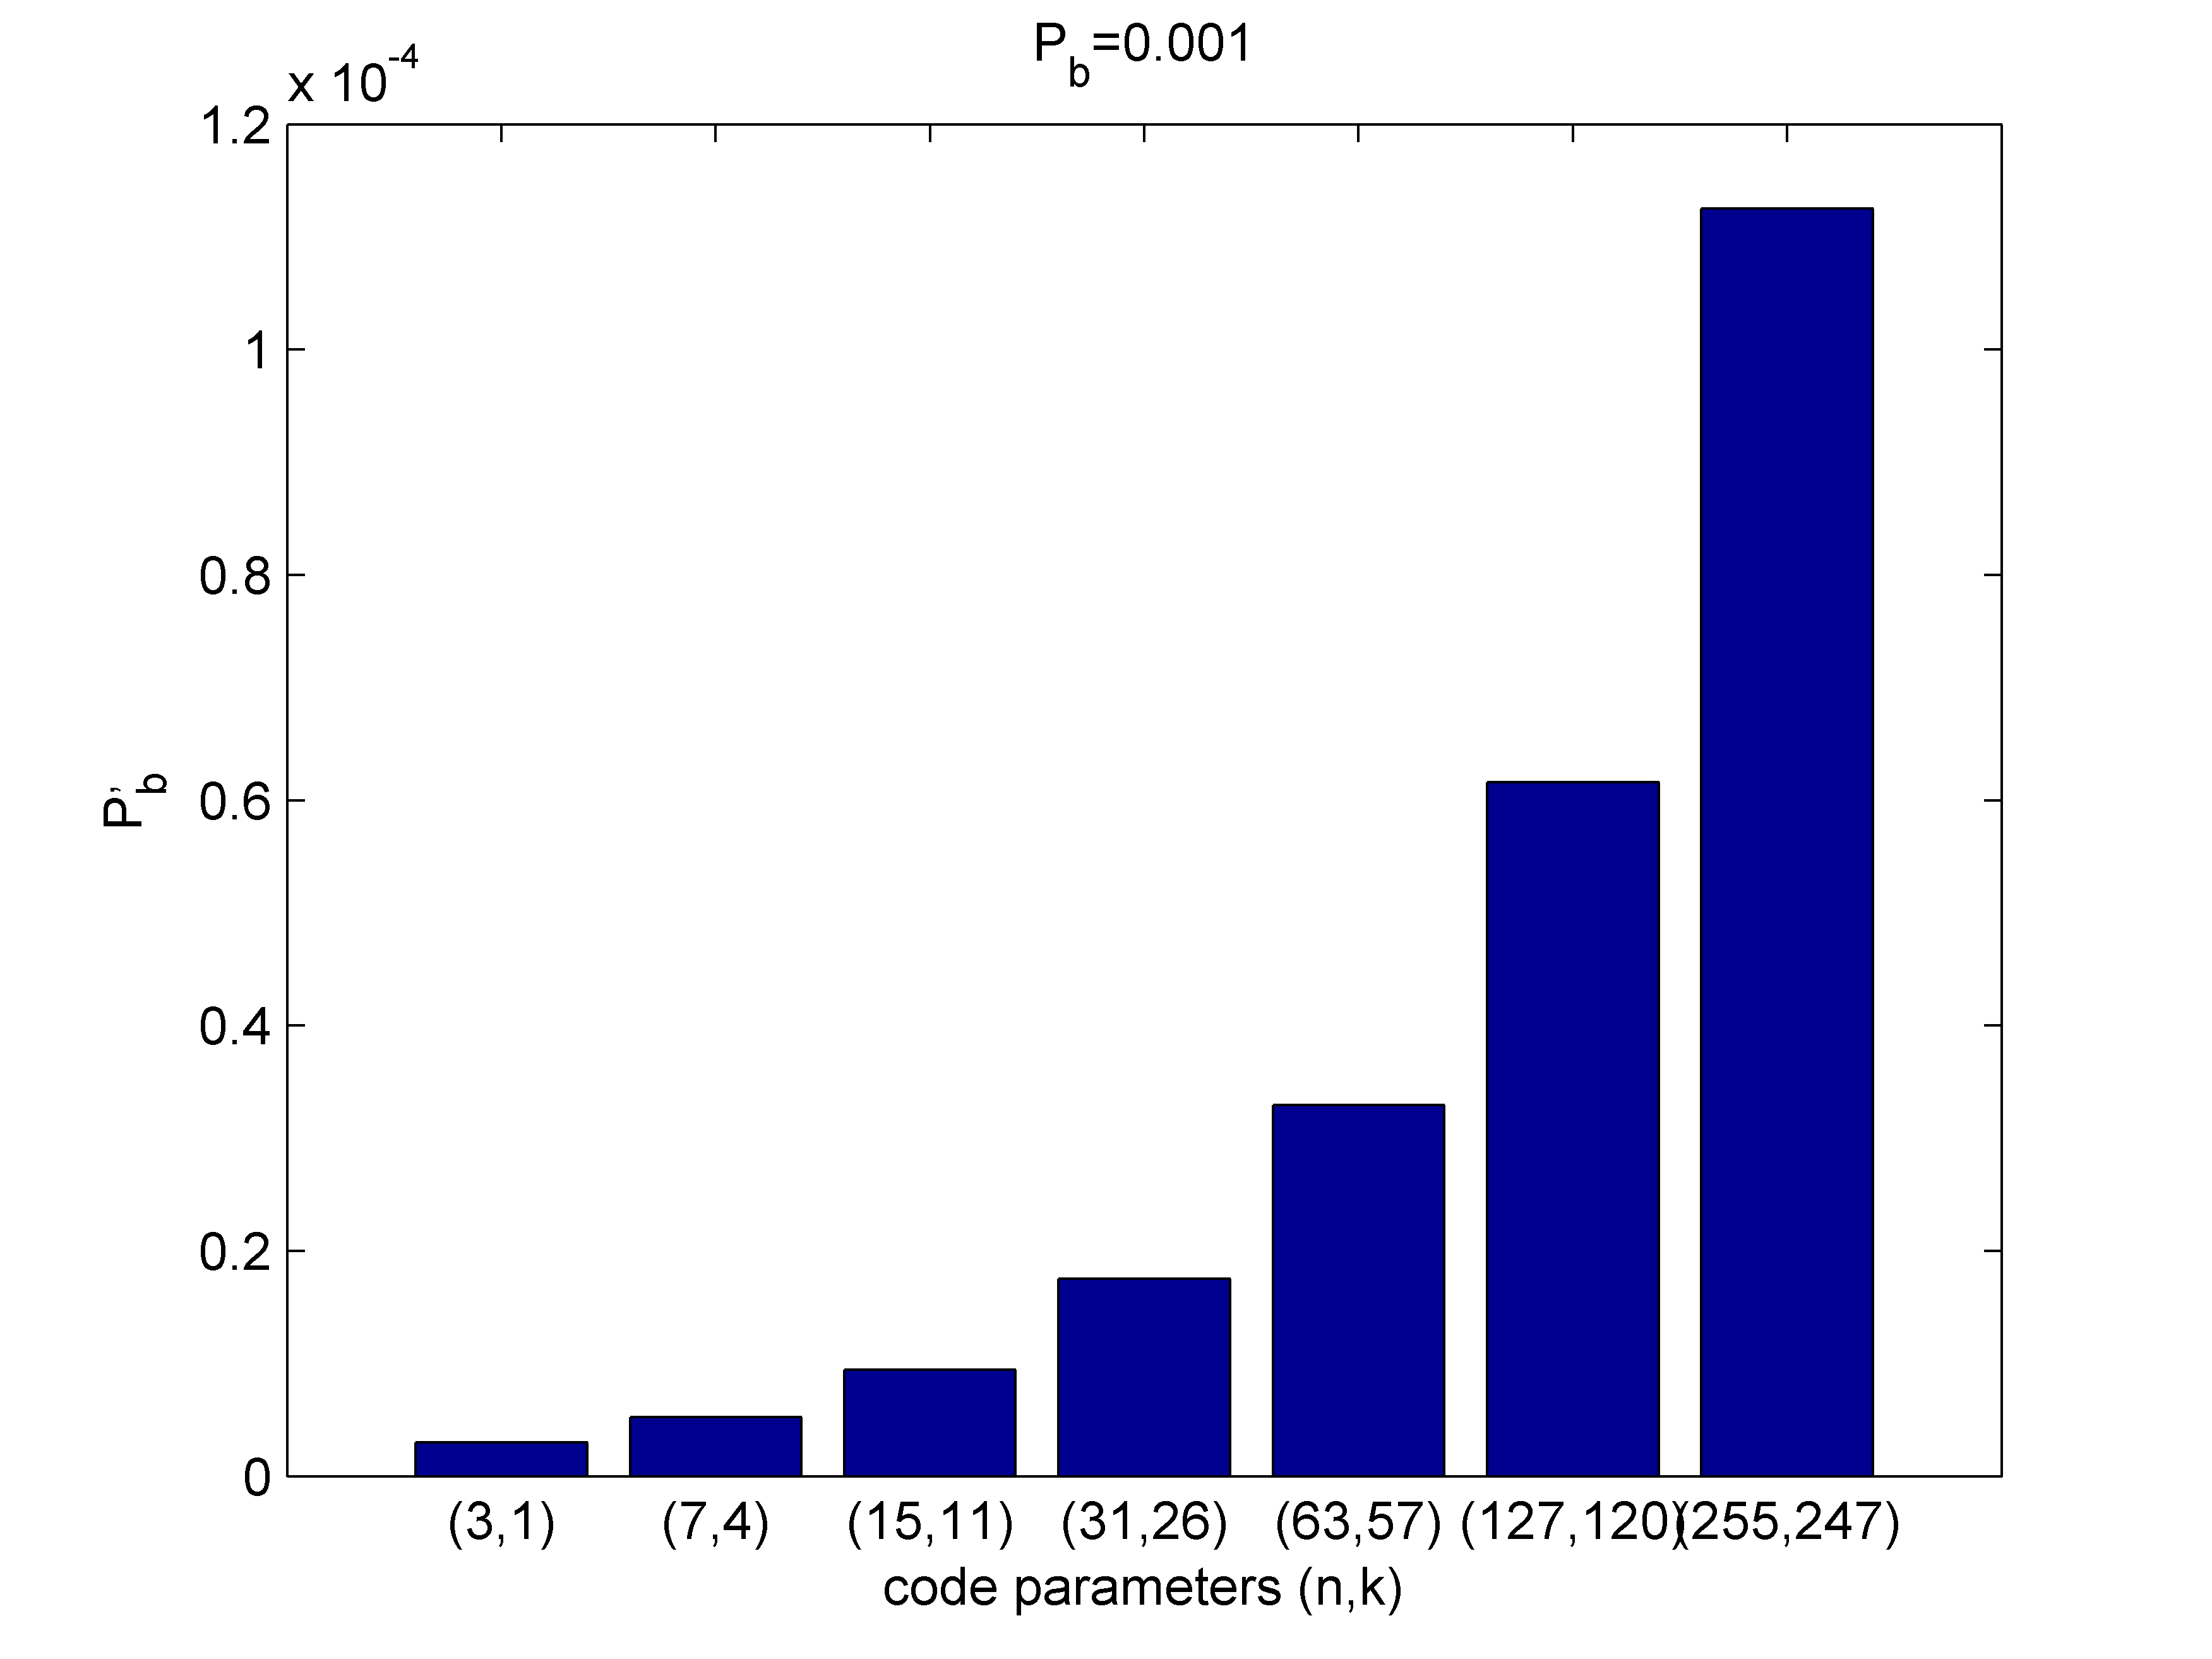
Design an error correcting code for a BSC (BER=0.01) to achieve BER’=0.00001
Step 1: indetifying the code parameters
n=7, k=4
Loss in data speed: 1/3; 4/7; 11/15; 57/63; 120/127; 247/255

Slide 17
Homework assignment
Design the coding scheme of a linear binary code with generator matrix
Determine the codewords
Give the parity check matrix H
Determine the error groups (give the Standard Array of the code)
Determine the syndrome decoding table
Evaluate the probability of the error vectors occuring in the syndrome decoding table
Give the scheme of the system
Describe all the binary vectors in the scheme when sending all the possible message vectors (in each cases let the error vector have 1 in the first component and rest of the components are zeros).

Slide 18
Help for the homework

Slide 19
Help for the homework
Pick
are known
s | e_s
000
001
010
011
100
101
110
111

Slide 20
Suggested readings
D. Costello: Error control codes, Wiley, 2005, Chapter 3

Slide 21
Expected Quiz question
Given a generator matrix of a linear binary systematic code, determine the error group belonging to a given error vector
Give the parity check matrix of the C(15,11) Hamming code

Slide 22
Thank you for your attention !

